Slide 1
Lender Club Case Study
Group member :
Akhsay and Rushikesh

Slide 2
Abstract
Lender club is online marketplace which lends business loan/personal loan to customer
Objective of this analysis from past information to get insight of data and identify pattern of customer who mostly like to default
Use of this Analysis allow lender to identify risky candidate and take appropriate business decision like loan rejection/increase in interest rate

Slide 3
Data cleaning
Filtering data:
Removing all null values
Removing unnecessary variable/columns
Transforming data:-
Converting data into standard data format e.g. ‘36 month’ is replaced with numeric 36
Unnecessary character in the column of dataset has been removed like +10 years has been roved to 10 years

Slide 4
Data Understanding
Worked with data dictionary and understand business term like Term, Loan_amnt ,annual_inc, avg_cur_bal, etc and their domain specific use
Data understand is most critical role in data analysis to get analysis better.
After analyzing data remove all irrelevant information like title and emp_title has been removed as these information don’t play any role in data analysis

Slide 5
Univariate analysis
Analysed each column by plotting distribution of data
Univariate analysis is useful tool to find any kind of outlier in our dataset.
Outlier should be removed for clean understanding of data
Performed segmented univariate analysis for continuous column against categorical column

Slide 6
Bivariate analysis
Bivariate analysis is performed on column like term and loan amount with respective to loan status.
Bivariate analysis are performed for finding defaulted loan customer and their pattern.
Bivariate analysis is useful for business to make decision based customer category like employment term
Will impact on loan status.

Slide 7
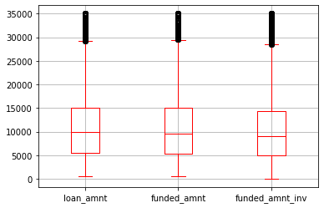
Chart Analysis:- Median of all loan amount is almost same i.e. almost all demanded loan is funded.

Slide 8
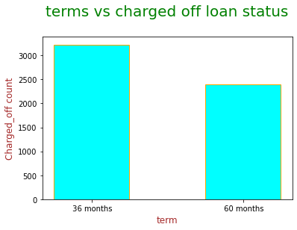
Observations :- Less tenure of loan is more likely to default than higher tenure
Observations:

Slide 9
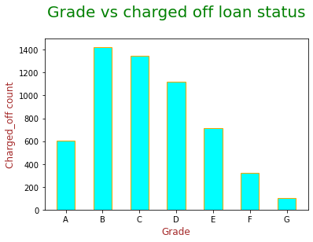
Observations :- Grade plays important role in loan default rate. Grade B loan is having highest default rate than loan having grade G

Slide 10
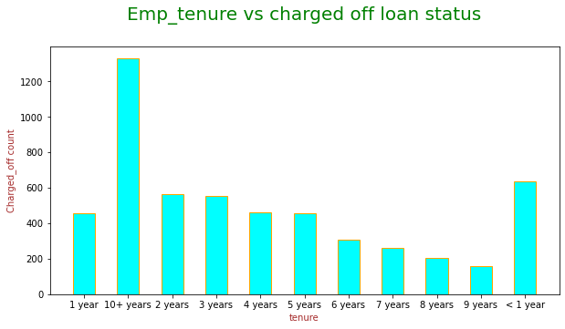
Observations :- Graph shows employee tenure of borrower is affecting loan default rate. Graph clearly shows than employee with more than 10+ years of experience are more likely defaulted person

Slide 11
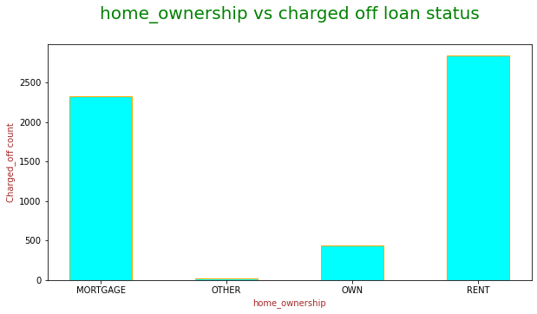
Observations :- Rented person are more likely default loan than person who own house

Slide 12
Thank You

